Slide 1

E-MAIL : 212976@ust-global.com Name : Neelakantam Suneel Kumar

Slide 2
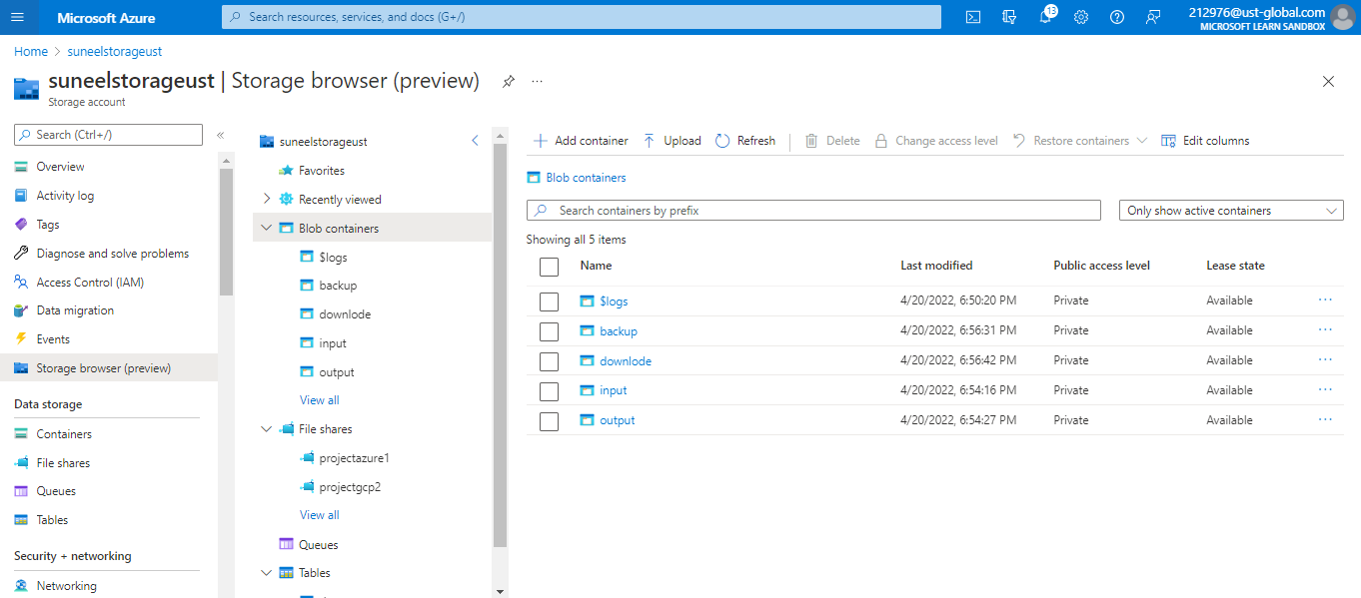
Storage Account in Azure with 4 containers (Input, Output, Backup, Download)

Slide 3
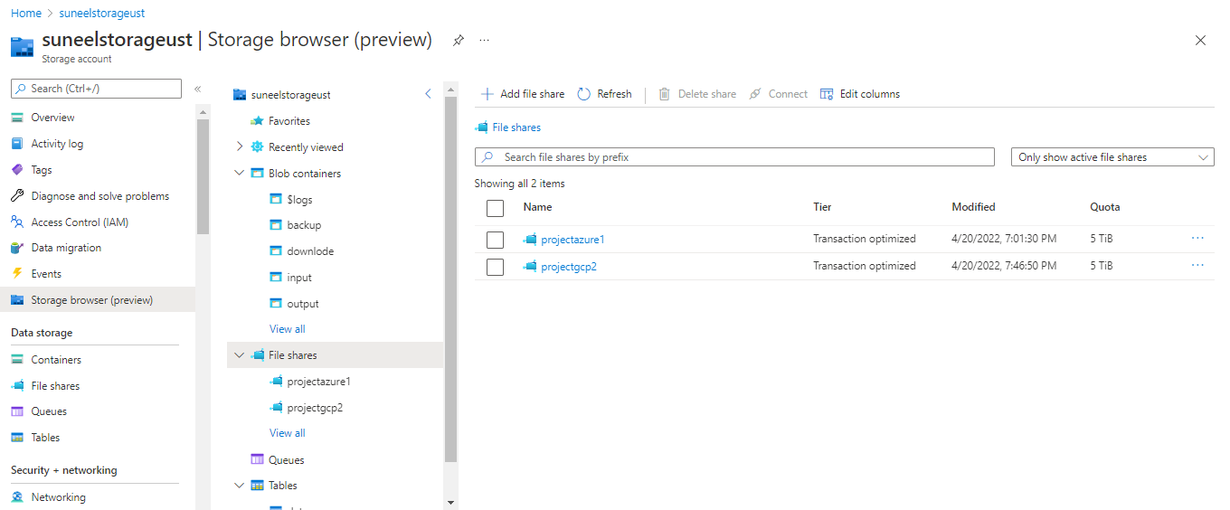
File share with 2 directories (Project Azure 1 , Project GCP2)

Slide 4
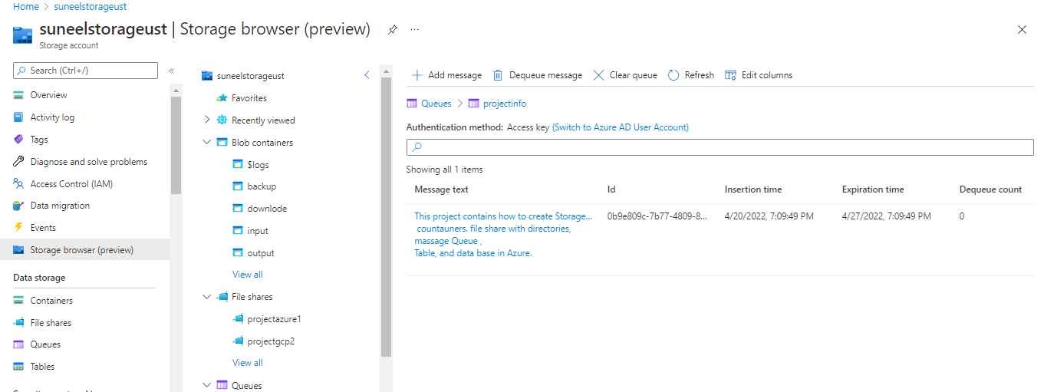
Message Queue with a message

Slide 5
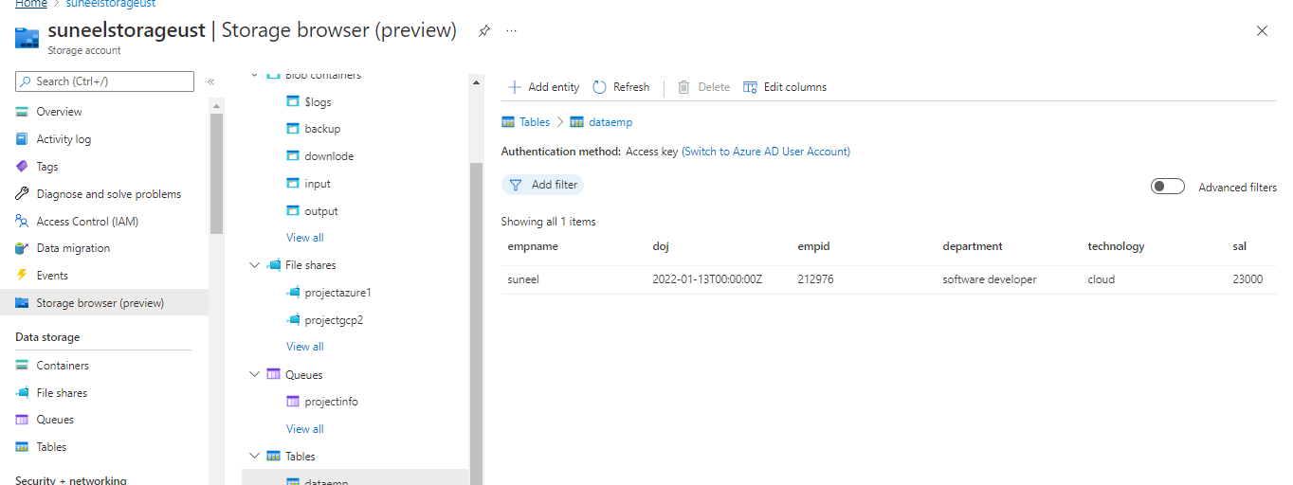
Table in Azure EMP Table

Slide 6
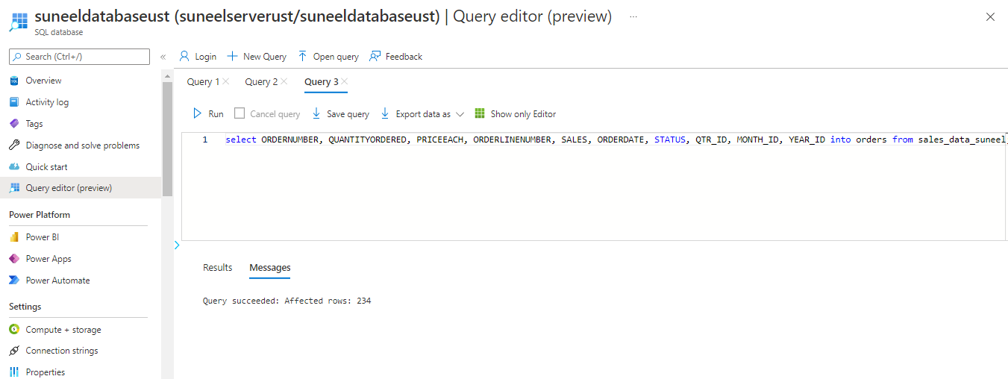
Sample Data Base

Slide 7

Dimensions

Slide 8

Dimensions

Slide 9
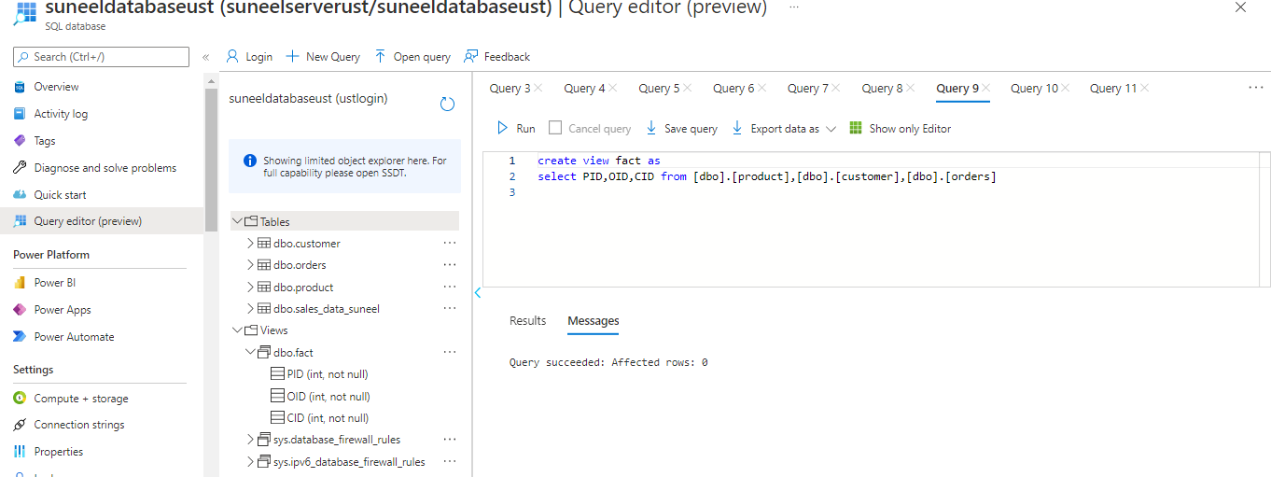
Fact Table

Slide 10
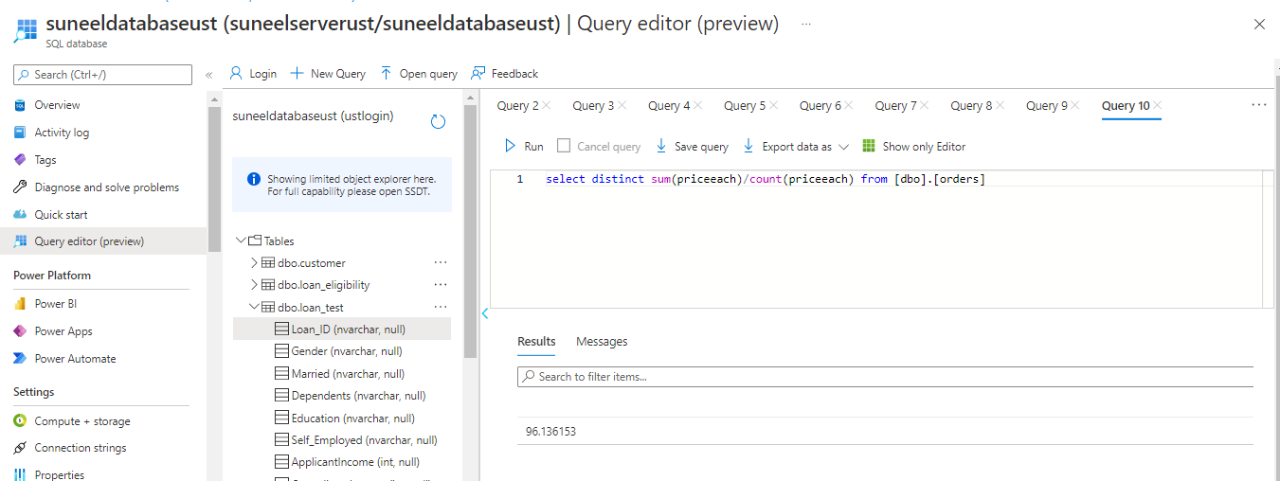
To Estimate the unit sales of retail goods

Slide 11
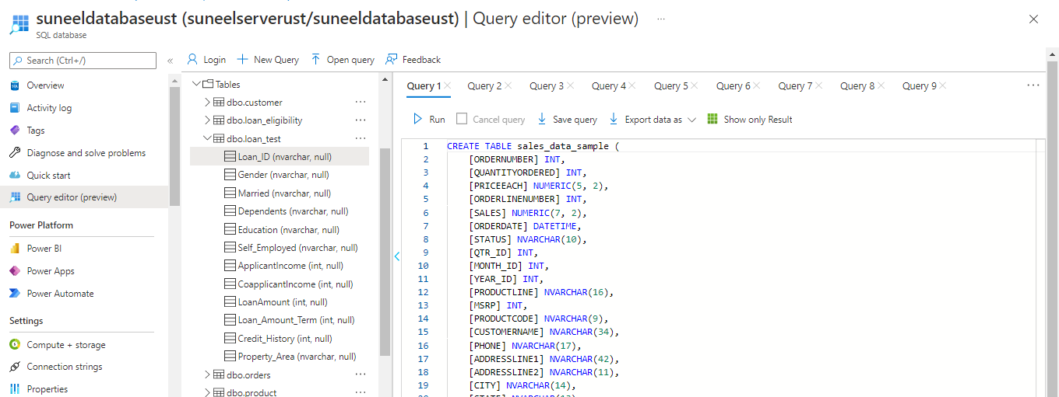
Sample Data Base :Table To Financial Need Programs for Consumer Loan Products

Slide 12
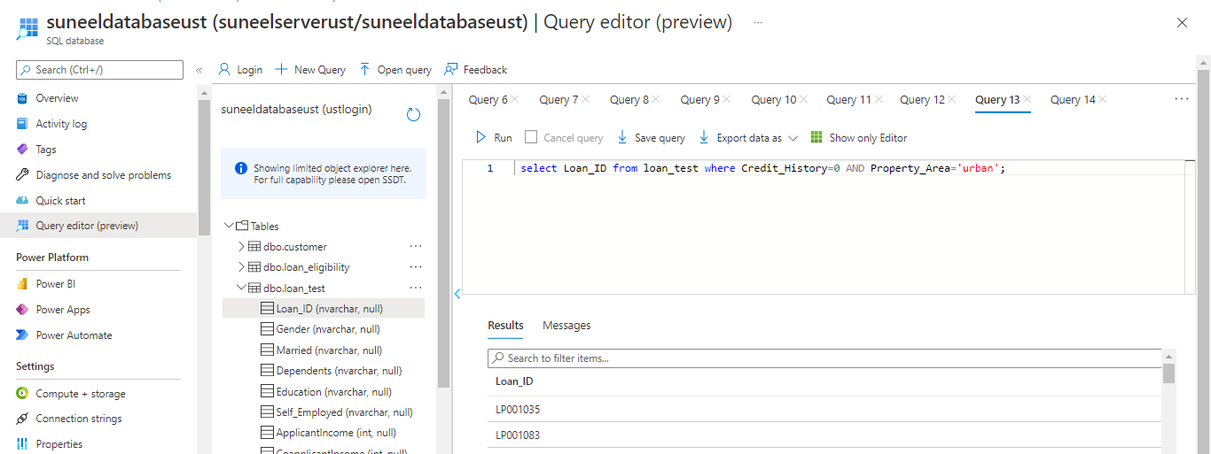
To Financial Need Programs for Consumer Loan Products

Slide 13
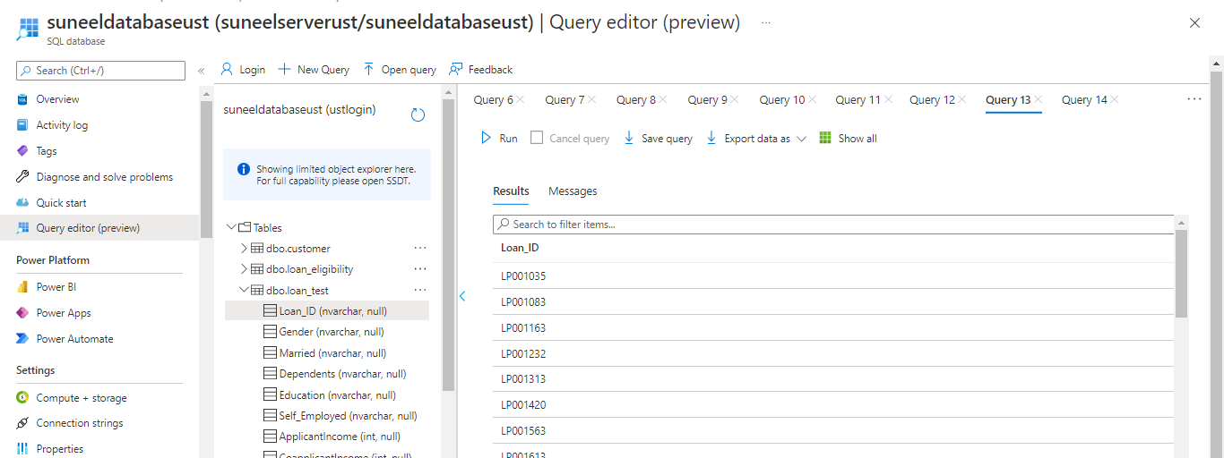
Output

Slide 14
THANK YOU

